Slide 1

Lakeland Amateur
Radio Club
March 11, 2024

Slide 2


Slide 3
ANNOUNCEMENTS

Slide 4

March 23rd
Heritage Day

Slide 5
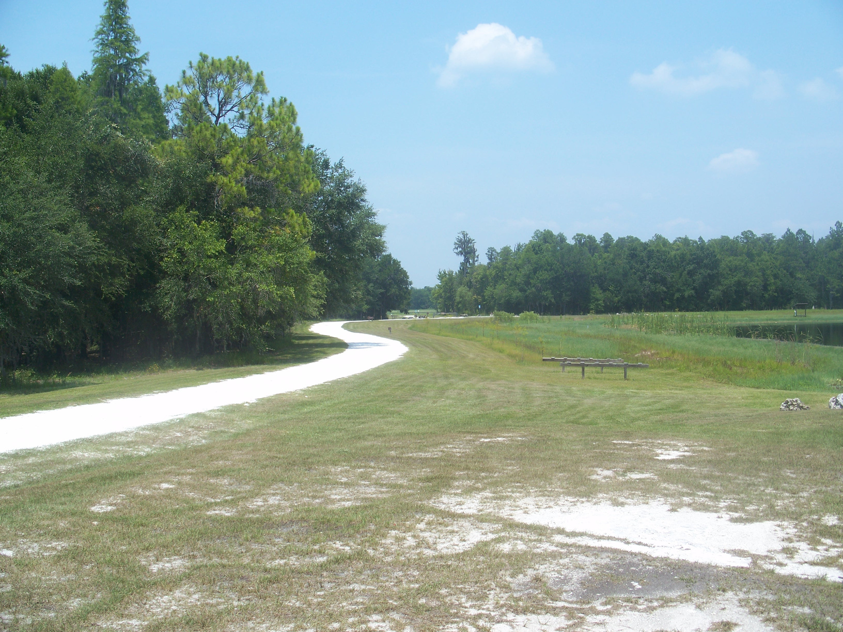
LARC Picnic
April 6ᵗʰ
Colt Creek State Park

Slide 6
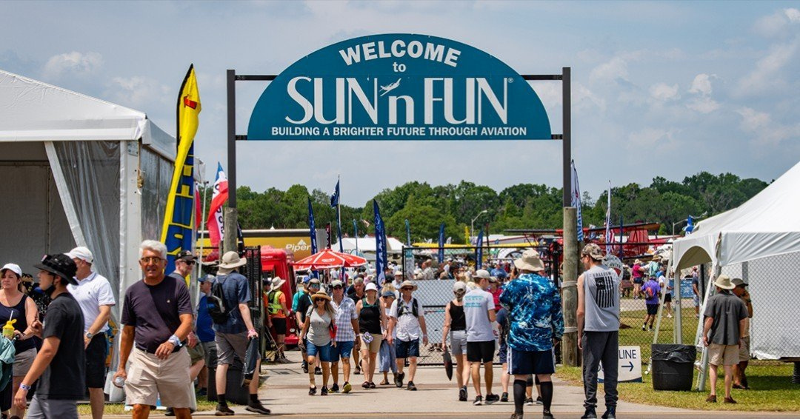
Sun N Fun
April 9-14

Slide 7

Postponed TBD

Slide 8

June 22-23

Slide 9


Slide 10


Slide 11

What is APRS?
Automatic
Packet
Reporting
System

Slide 12
  Invented by WB4APR Bob Bruninga (SK) in 1982 to plot Naval positions, first used as Connectionless Emergency Traffic System in 1984
  Data Mode
  Usually on 144.390 in the USA (can be on other frequencies)
  Can include GPS object location, weather, text messages, email, announcements, queries, and telemetry
  Was originally local but now can be digi-peated or even sent to/through the internet
  Built on AX-25 and is broadcast (fire and forget) as opposed to session based

Slide 13
TNCs,
Digi-peaters,
and I-Gates
(Oh my!)

Slide 14
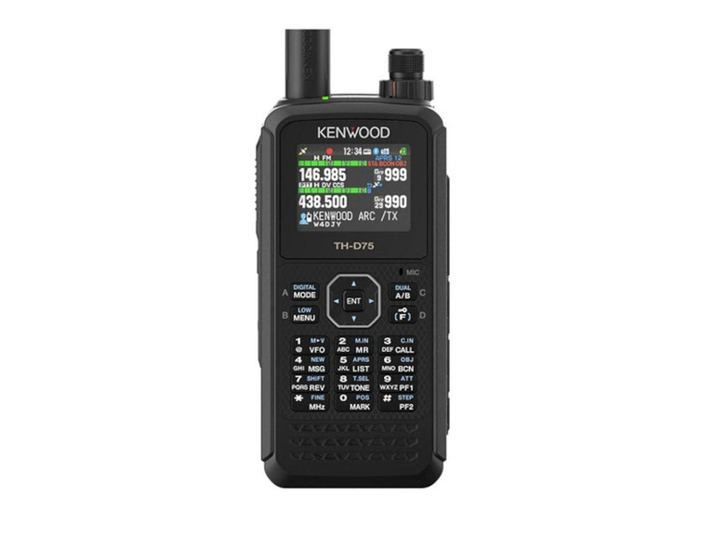
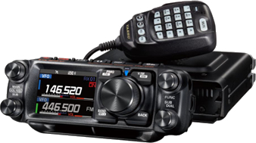
Transceiver + TNC/Sound Card/Modem
Some radios all in one

Slide 15
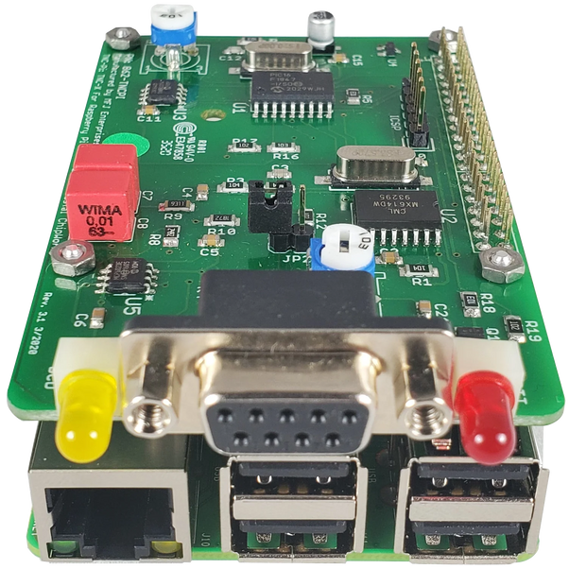
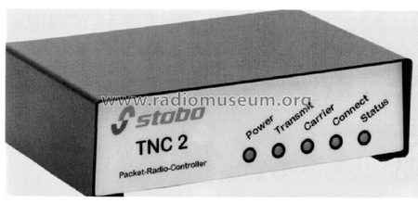
Transceiver + TNC/Sound Card/Modem
Some radios all in one
Can be radio plus TNC/Sound Card/Modem Hardware

Slide 16
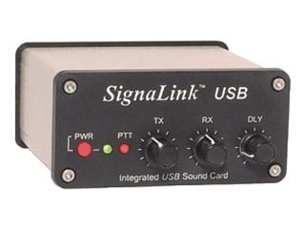
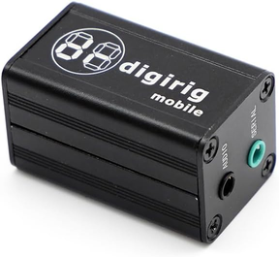
Transceiver + TNC/Sound Card/Modem
Some radios all in one
Can be radio plus TNC/Sound Card/Modem Hardware
Can be radio plus sound card plus software based TNC/modem

Slide 17
DIGI-peater
Digital Repeater.

Slide 18
DIGI-peater
Digital Repeater.
Polk is well covered by its APRS DIGI-peater network

Slide 19
DIGI-peater
Digital Repeater.
Polk is well covered by its APRS DIGI-peater network
WC4PEM (Polk Emergency Management) and others contribute to a mesh network that covers most of Polk

Slide 20
i-Gate
Internet Gateway

Slide 21
i-Gate
Internet Gateway
Can be listen only or can also DIGI-peat/inject traffic from the internet.

Slide 22
i-Gate
Internet Gateway
Can be listen only or can also DIGI-peat/inject traffic from the internet.

Slide 23
i-Gate
Internet Gateway
Can be listen only or can also DIGI-peat/inject traffic from the internet.
This means traffic from one person can pass from one i-Gate to another i-Gate that has recently heard the intended recipient

Slide 24

Most “beaconed” info can be found at the website aprs.fi

Slide 25
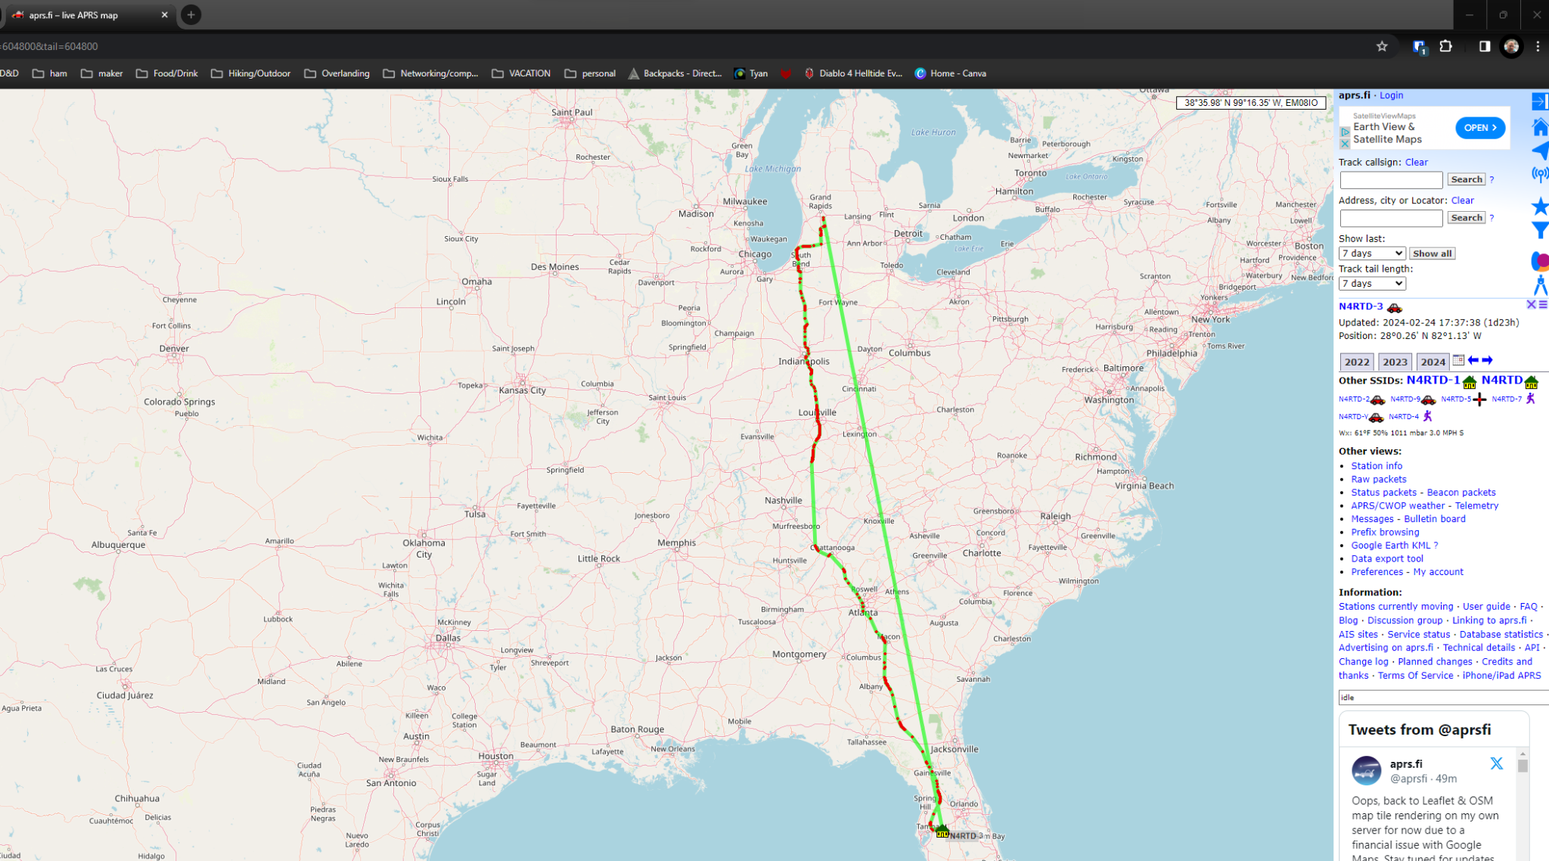

Slide 26
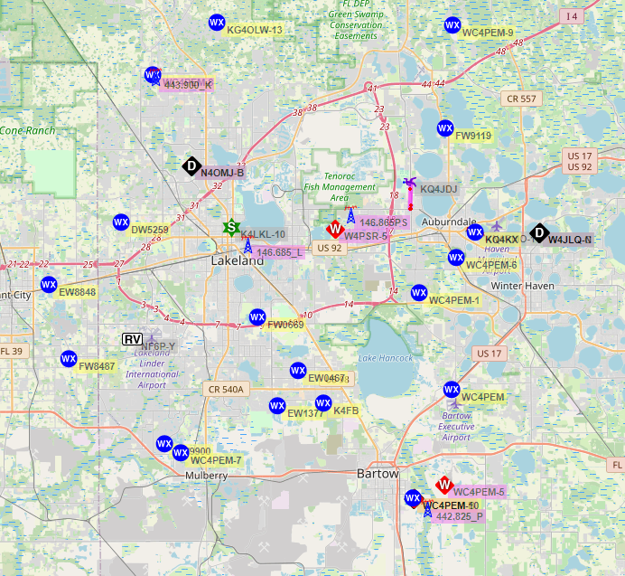

Slide 27
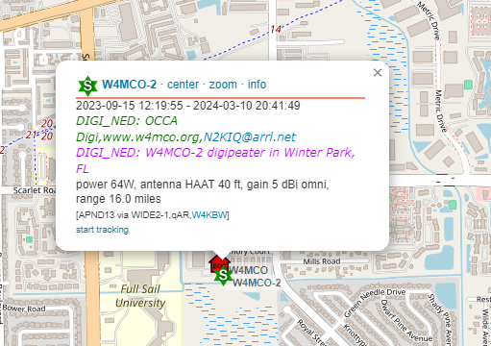
DIGI-peater

Slide 28
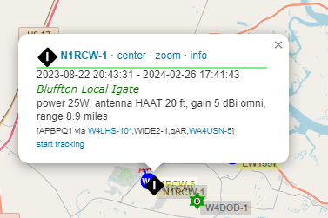
i-Gate

Slide 29
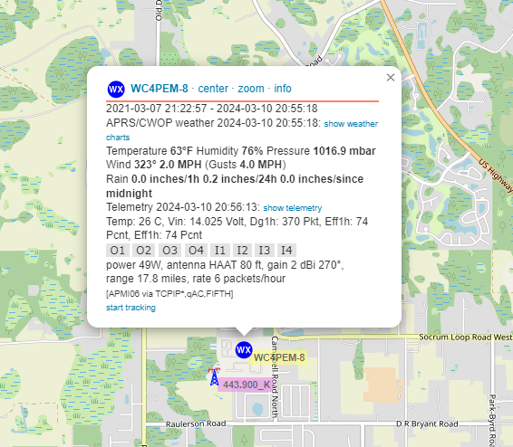
Weather Station

Slide 30
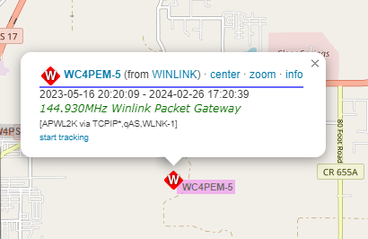
Winlink RMS Server

Slide 31
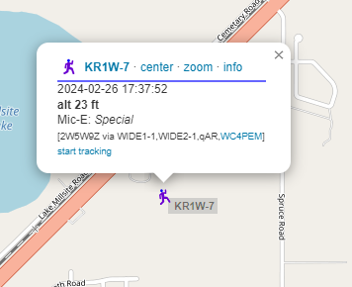
Some Random Dude on a handheld

Slide 32
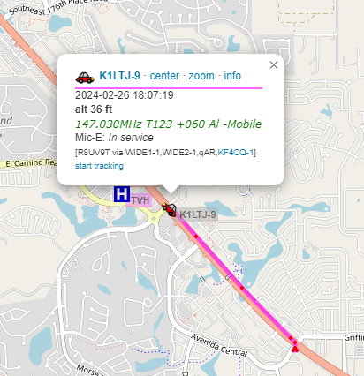
Vehicles

Slide 33
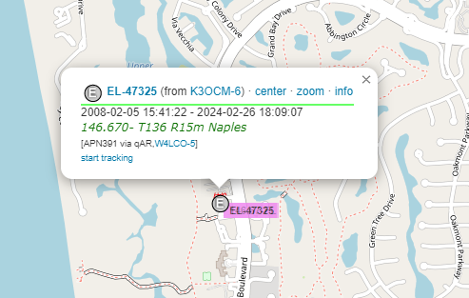
Echo-Link Connection

Slide 34
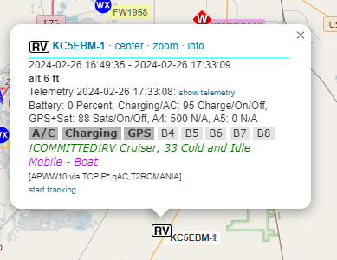
RV telemetry!?!?!

Slide 35
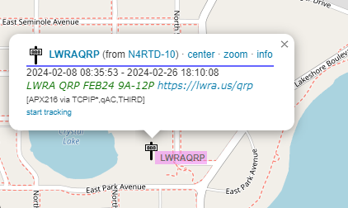
Event or special interest marker

Slide 36
Positioning and Telemetry are just the tip of the iceberg
SMS messaging (https://aprs.wiki/SMS/)
Winlink (https://www.winlink.org/APRSLink)
Weather report message (https://sites.google.com/site/ki6wjp/wxbot0
and much more

Slide 37
Thank
you!

